Slide 1
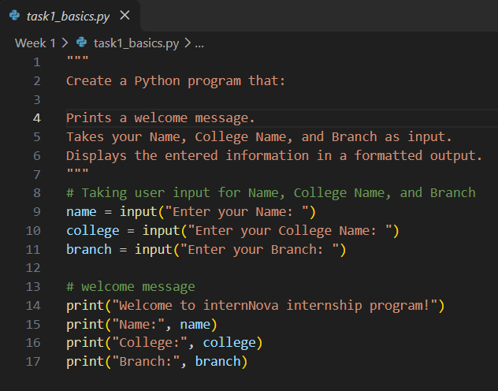
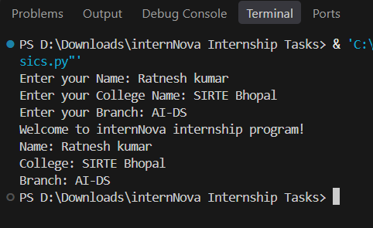
Task 1: Python Basics (10 Marks) Create a Python program that: Prints a welcome message. Takes your Name, College Name, and Branch as input. Displays the entered information in a formatted output
Program
Output

Slide 2
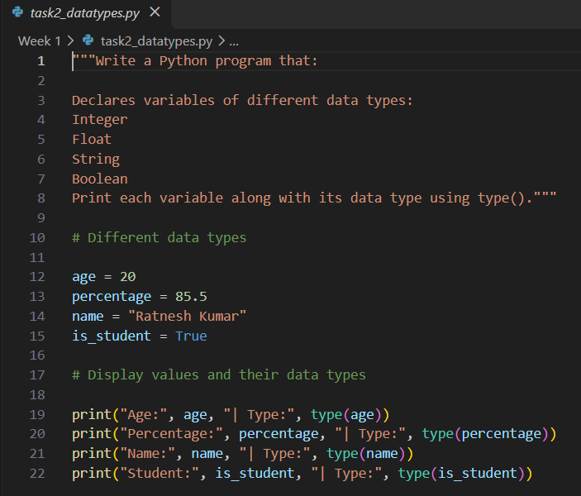
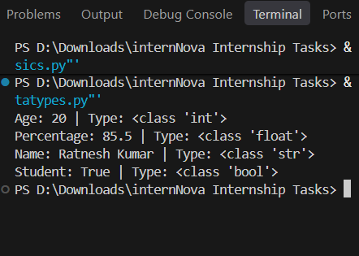
Task 2: Variables & Data Types (10 Marks) Write a Python program that: Declares variables of different data types: Integer Float String Boolean Print each variable along with its data type using type().
Program
Output

Slide 3
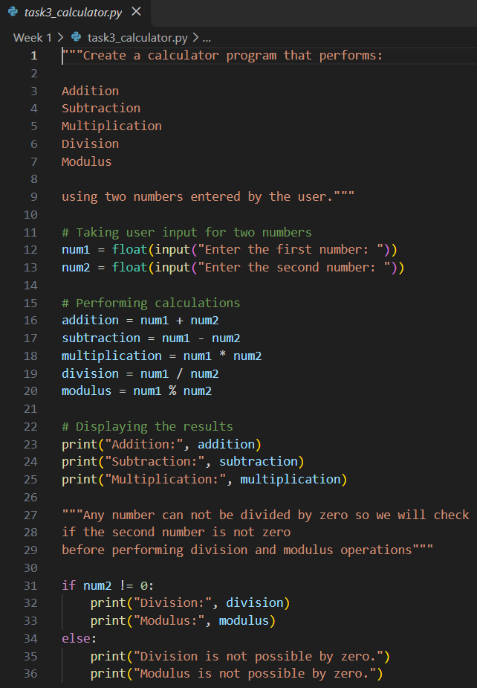
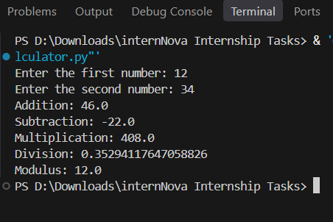
Task 3: Operators (10 Marks) Create a calculator program that performs: Addition Subtraction Multiplication Division Modulus using two numbers entered by the user.
Program
Output

Slide 4
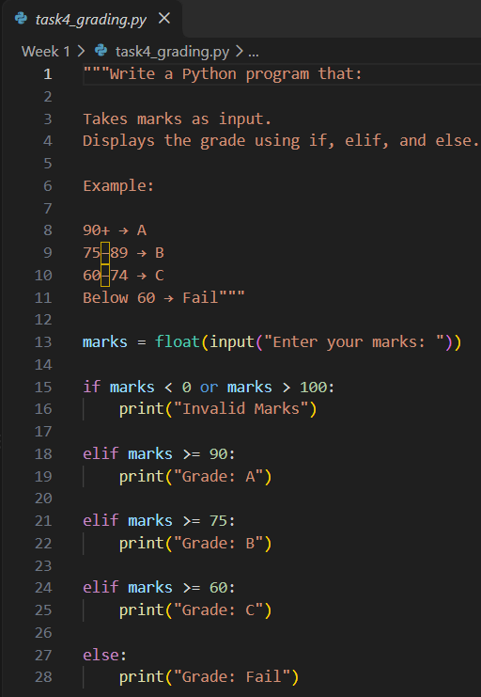
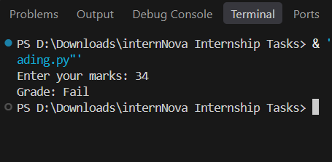
Task 4: Conditional Statements (10 Marks) Write a Python program that: Takes marks as input. Displays the grade using if, elif, and else. Example: 90+ → A 75–89 → B 60–74 → C Below 60 → Fail
Program
Output

Slide 5
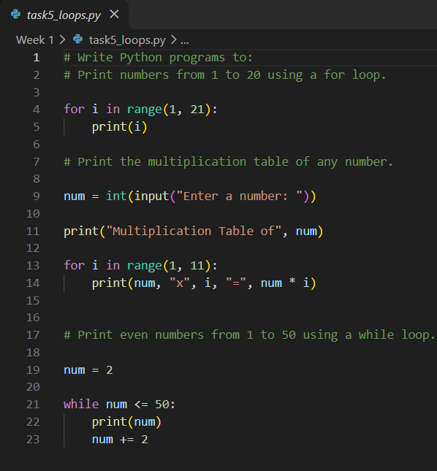
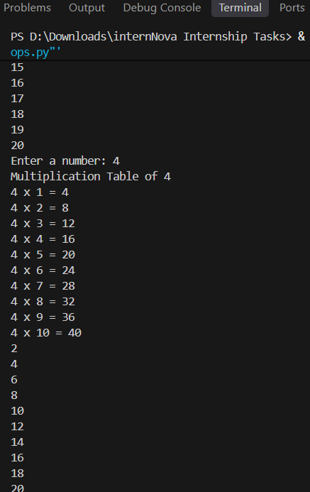
Task 5: Loops (10 Marks) Write Python programs to: Print numbers from 1 to 20 using a for loop. Print the multiplication table of any number. Print even numbers from 1 to 50 using a while loop.
Program
Output

Slide 6
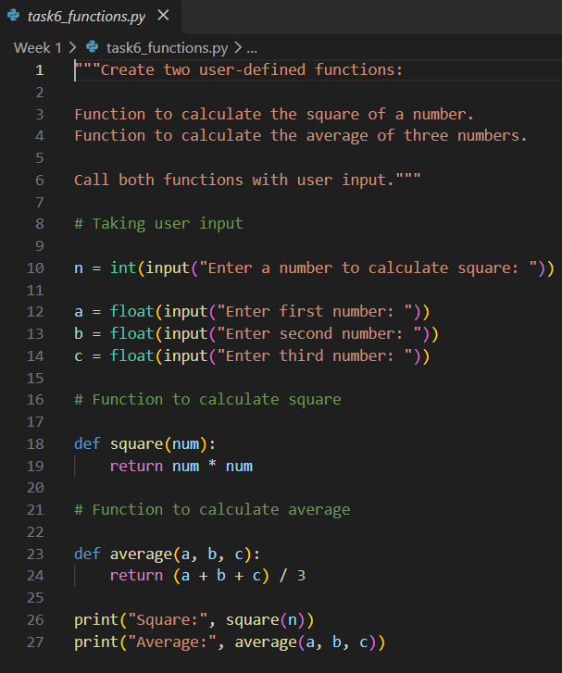
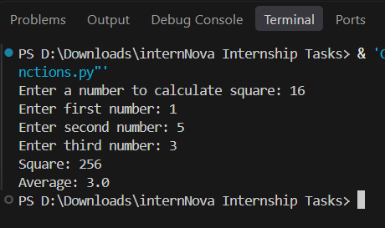
Task 6: Functions (10 Marks) Create two user-defined functions: Function to calculate the square of a number. Function to calculate the average of three numbers. Call both functions with user input.
Program
Output

Slide 7
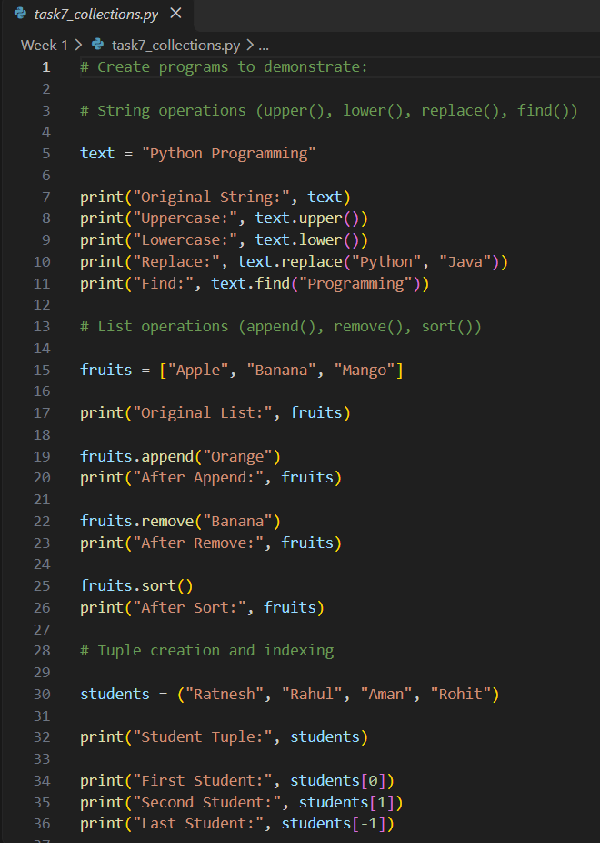
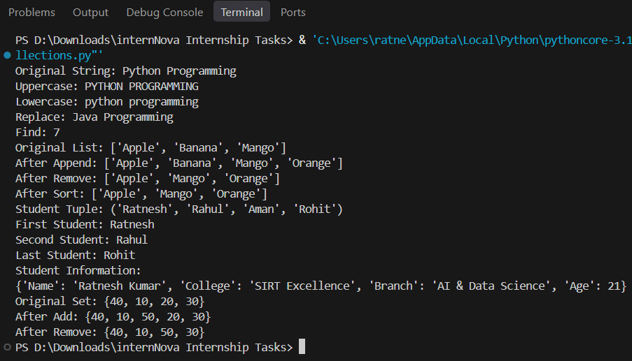
Task 7: Strings & Collections (15 Marks) Create programs to demonstrate: String operations (upper(), lower(), replace(), find()) List operations (append(), remove(), sort()) Tuple creation and indexing Dictionary storing student information Set operations (add(), remove())
Program
Output

Slide 8
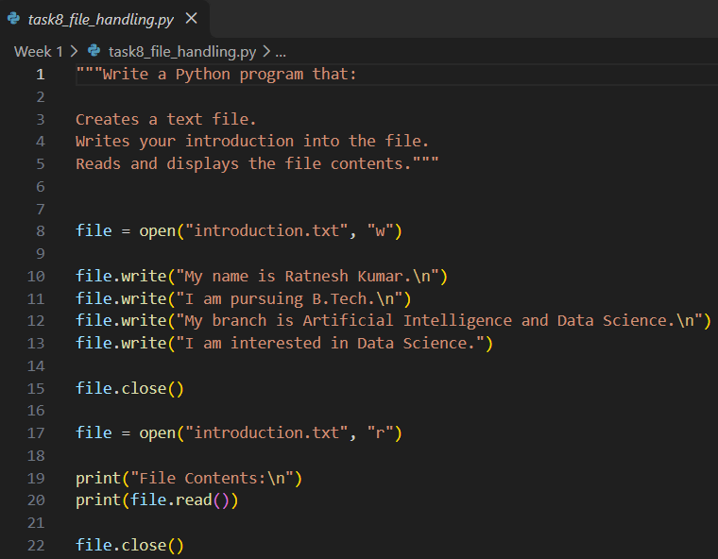
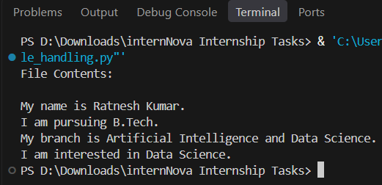
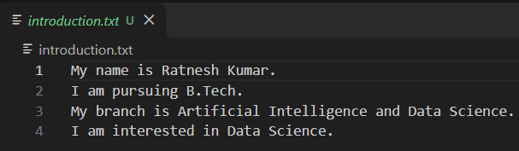
Task 8: Basic File Handling (10 Marks) Write a Python program that: Creates a text file. Writes your introduction into the file. Reads and displays the file contents.
Program
Output

Slide 9
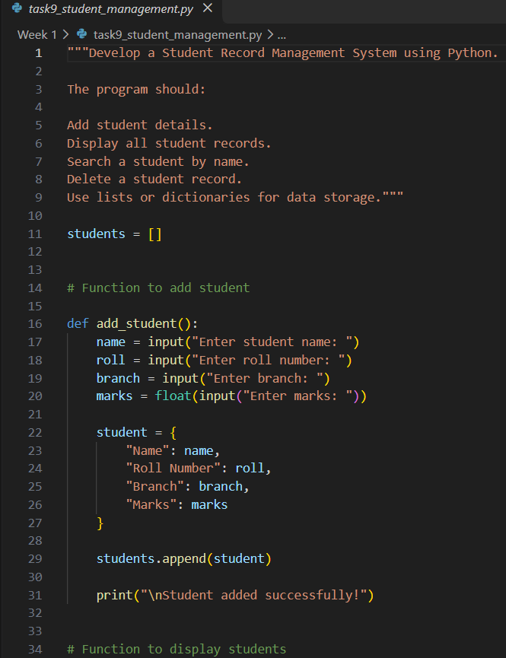
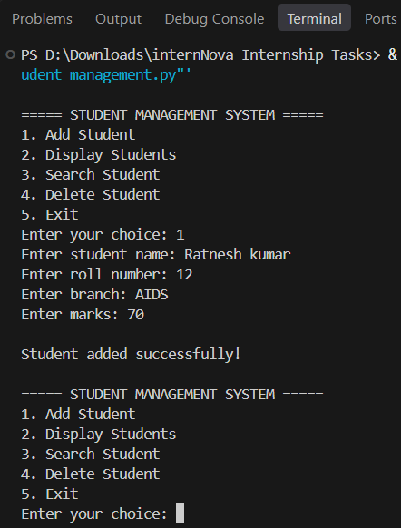
Task 9: Mini Python Project (15 Marks) Develop a Student Record Management System using Python.
Program
Output

